Slide 1
Creating great CLIs
Kathleen Dollard
.NET Connoisseur

Slide 2
CLIs are ubiquitous – and they have never been more important.
Your guide….NET CLI…System.CommandLine
has guided many people in CLI design.
…all CLIs…are languages – domain specific languages or DSLs.
They…have a special gift for you and your users of strong user expectations leading to fewer decisions for you
Looking to the future, CLI First design strategy results in human and AI friendly interfaces that are easy to explore and a good basis for modeling APIs

Slide 3
Agenda
Intro
Basic CLI rules/guidelines
Syntax building blocks & using System.CommandLine
Designing your syntax
CLI First
Future

Slide 4

Who am I?

Slide 5
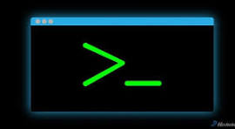
Why you care about creating CLIs?
Easy access to app
Friendly to AI
Early demos
Testing and debugging
Common patterns (POSIX)
Scriptable

Slide 6
Resources
Kathleen.A.Dollard@gmail.com
Slides at: https://github.com/KathleenDollard/GreatCli
System.CommandLine, the parser used by the .NET CLI & most .NET Tools, https://www.nuget.org/packages/System.CommandLine
Spectre.Console.Cli, third party parser which also has awesome widgets, https://spectreconsole.net/cli/
Cocona, now archived, nice UI but apparently will get no security updates
DragonFruit2, wrapper for System.CommandLine that replaces API calls with Roslyn generation from classes and methods – in early development, https://github.com/KathleenDollard/DragonFruit2
TUIs are back…, Andres Pineda, GUI like terminal interface,s https://www.youtube.com/watch?v=Z6e5ZP9y3_8&t=1200s

Slide 7

Use POSIX standard
Use POSIX standard
It won
POSIX is the standard behind almost all CLIs
System.CommandLine for public CLIs because it matches the POSIX interpretation in the .NET CLI
Spectre.Console is also quite good

Slide 8

Do not write a CLI parser!
There are good ones,
including those in Resources
Getting POSIX correct is harder than you think

Slide 9

CLIs can never change, but can be extended
Expect your CLI to be used in scripts
You will not know who wrote scripts
Scripts will break if you change your CLI
This may not apply to in-house or personal scripts

Slide 10


Respect stdout and stderr
Limit stdout to data output
It may be piped to another command
Console.WriteLine(…
Consider a --debug switch for extra output
Limit stderr to warnings and errors
Also, return zero for success and
non-zero when there are errors
Console.Error.WriteLine(…

Slide 11
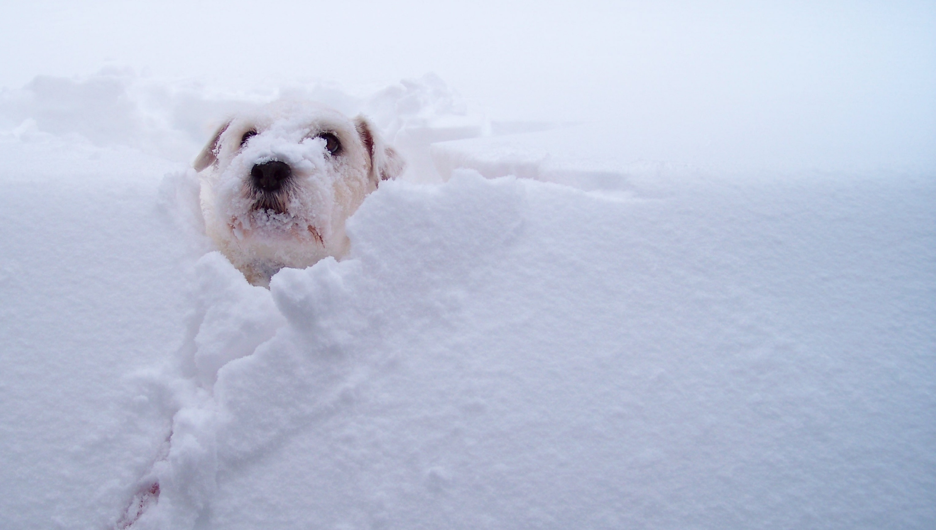
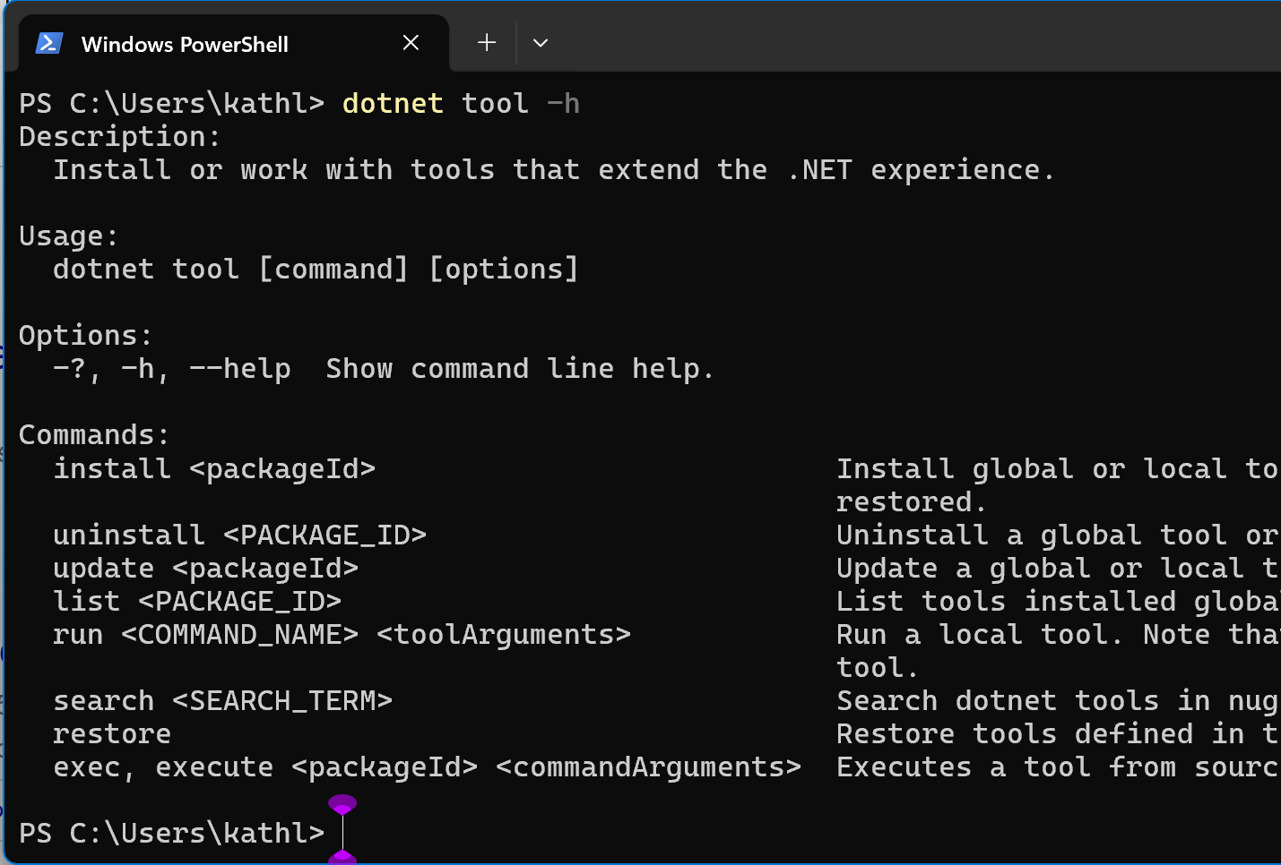
Help is essential

Slide 12
Isolate your parser
Generally, with a Library project for functionality and a Console project for the parser
Skip this for near-trivial CLIs
HelloWorldConsole.exe
HelloWorld.lib

Slide 13
Be careful with prompts
They will cause scripts to freeze (not error)
Confirmation prompts can be annoying
Prompts for required information are nice, but not in scripts
Use a --force option to avoid prompts
  -f is also used for other things, so I dislike its use for --force

Slide 14
Follow style and ecosystem traditions
Kebab case for multiple words
Case sensitive (and yes, I hate this)
Option names are prefixed with a double dash --
One letter abbreviations are prefixed with a dash-
  You only have 23-25: -h is taken, -f and –v have standard meanings (2 for each ☹️)
  You can use capitals, but may cause confusion 😟
Use -- for multi-letter abbreviations to avoid conflict with stacking/coalescing
  This can be helpful for long words
A double dash -- appearing alone passes the rest of the line to the operation

Slide 15







stderr and stdout have different purposes

Slide 16
Syntax building blocks
Commands, (also root command, and subcommands)
  dotnet new console --output MyConsoleApp
Options or named arguments
  dotnet new console --output MyConsoleApp
Arguments or positional arguments
  dotnet new console --output MyConsoleApp
Options frequently have arguments
  dotnet new console --output MyConsoleApp

Slide 17
Your CLI is a
Domain
Specific
Language

Slide 18
Design questions to ask
Base answers on where you want your app to be in five years
Invest brainstorming effort on this early
What are the things that will be worked on by your app?
  These are probably areas
What are the actions to be performed on each thing?
Is there one area or do most commands work on a single area?
  This the core area
What operations are common across many areas?
  add, remove, and list are common
Draw a tree – mermaid markdown is helpful
Iterate on this design

Slide 19
Noun/Verb?
V build
N build-server
V clean
V format
V help
V msbuild
new
N nuget
V pack
N package
V publish
N reference
V restore
V run
N sdk
N solution
V store
V test
N tool
V vstest
N workload
[exe name] [noun] [verb] is not a helpful rule
  Think instead of areas, perhaps with a core or implied area
  For dotnet, PROJECT | SOLUTION | FILE, is the implied area
  Noun/area first for operations other areas
  dotnet package add…
There are some outliers
  help displays the MSLearn (docs) web page
  nuget is a separate CLI, resulting in some 3 command nesting
  msbuild acceses a separate “CLI” with its own syntax

Slide 20
Noun/Verb? (cont’d)
V build
N build-server
V clean
V format
V help
V msbuild
new
N nuget
V pack
N package
V publish
N reference
V restore
V run
N sdk
N solution
V store
V test
N tool
V vstest
N workload
new is generally an adjective, but is used here as a verb
  It’s also an area because you can install, uninstall & search
  list means list those available, not templates in the project
In my experience, all CLIs are imperfect
  The key is does it feel OK to a new user
  And remember, you can’t change as you evolve, so sometimes you just live with stuff
  If starting from scratch, new might have been template
As long as you start with what would be the natural core or implied area, you can add other areas later

Slide 21
Noun/Verb? (cont’d 2)
V build
N build-server
V clean
V format
V help
V msbuild
new
N nuget
V pack
N package
V publish
N reference
V restore
V run
N sdk
N solution
V store
V test
N tool
V vstest
N workload
nuget has verb that work on two implied areas
  Most of its commands work on sources, but delete & push work on the server and verify & sign work on packages
  And does it make sense for a subcommand that is clearly an area to even have an implied sub area?
test and vstest are a bit of a mess, partially because the areas are complex, and also legacy
  test behaves differently depending on configuration, although that is partially a difficult point in time

Slide 22
One CLI or many
A single entry point allows help to display all available commands
  This is bad if you have 140 commands
Very small CLIs mean there are more exe names to remember
If you have a clear distinction in user role, security, frequency of use (particularly when that is “never”), etc. use two CLIs

Slide 23
Learn from other CLIs
(good and bad)

Slide 24
A very imperfect CLI: git
Not grouped by area, see git -h
Also, git uses upper- and lower-case abbreviations
There are a huge number of options
  -c and -C do very different things; also -p and -P
  Isn’t that confusing?
There are 140+ commands, since plumbing commands are included
  AI says you only need ten

Slide 25
Getting the details right
Name your areas thoughtfully
  Most common name, among synonyms pick short and easy to spell
  Do not use context for naming
  IMO, synonyms are OK if they provide a clear easy to type abbreviation
Use one letter abbreviations sparingly and in clear and consistent ways
Devil really is in the details

Slide 26
CLI First
Premise: The rules for a great CLI make a good or great API
Benefit: a single conceptual surface with two modes of access
Areas are classes
  Help define class boundaries
  Can identify classes that will grow to be too big early
Verb commands are methods
Since designing a CLI is done via an outline, it’s easy to experiment
CLIs are limited in data, so tie this with JSON structures for data

Slide 27
Future predictions
One or more parser APIs that are easier to use will emerge
Help will get better, although not fast enough
More often, terminal UIs will support CLIs, such as requesting missing data that is required and offering selection from lists
Hybrid tab completion will become more common
  Very fast where the CLI structure is known
We might see more grouped CLIs like az or .NET Tools that allow you to bring subcommands

Slide 28
DragonFruit2
Common semantic CLI models will empower future CLIs to
Have plug-in features
Color (while respecting ANSI colors/themes) and better help and output
Hybrid tab completion combining perf and flexibility (like NuGet packages)
Web based replacement for man pages automatically created
Lazy command definitions
Reusable help descriptions

Slide 29
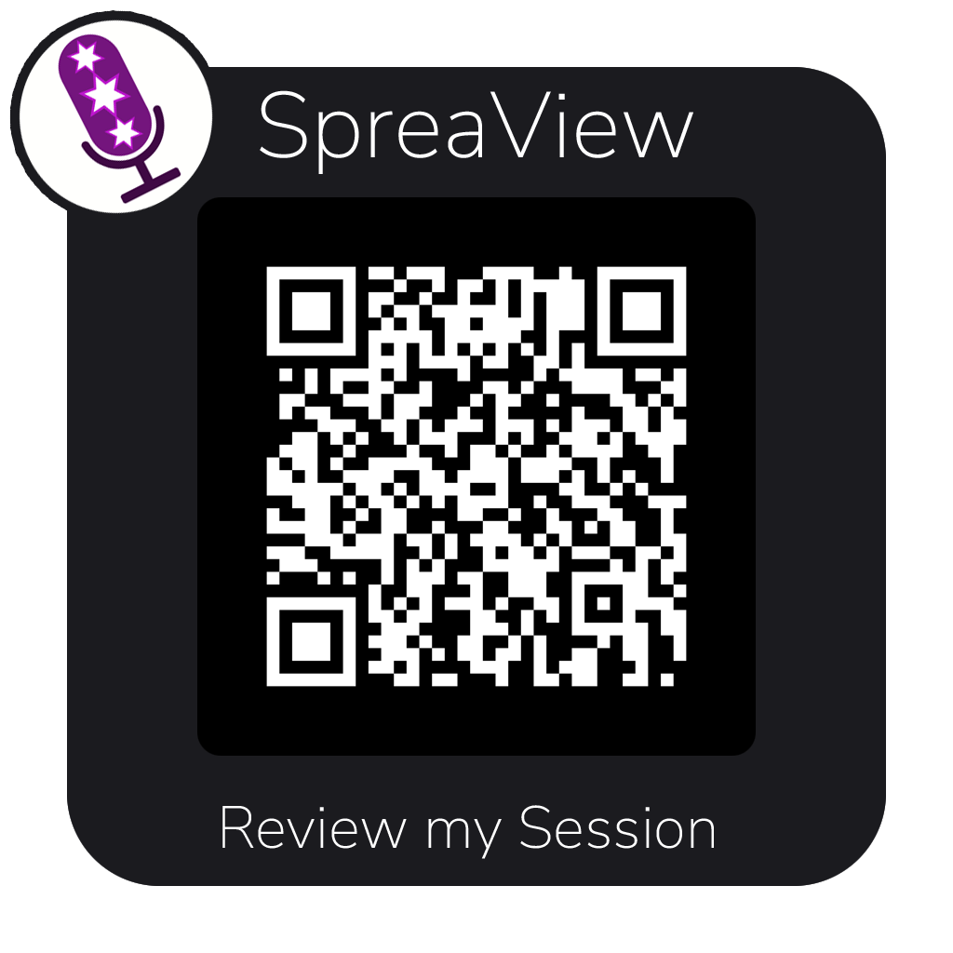

Thank you!

